Slide 1

Project Title - AI-Based Network Intrusion Detection System
Student Name: Subramani Meghna
AICTE ID : APPLY_176426115269287d2037e12

Slide 2

PROBLEM STATEMENT
Modern computer networks generate a massive volume of traffic every second.
Traditional security systems such as firewalls and intrusion detection systems(IDS) fail to detect new and evolving cyber-attacks like DDoS(Distributed Denial of Service), port scanning, and web-based attacks.
Therefore, there is a need for an intelligent, adaptive, and data-driven Network Intrusion Detection System (NIDS) that can analyze network traffic patterns in real time.

Slide 3
Project Description
The system uses the Random Forest classification algorithm to analyze network traffic features and classify them into:
Benign Traffic (Normal)
Malicious Traffic (Attack)
An interactive Streamlit dashboard is developed to visualize results, simulate live traffic, and explain attack detection using both rule-based logic and Groq AI explanations.
The model analyzes important network traffic attributes such as:
Destination Port
Flow Duration (ms)
Total Forward Packets
Packet Length Mean
Active Mean Time
These features help identify abnormal patterns commonly associated with cyber-attacks.

Slide 4

WHO ARE THE END USERS?
Network Administrators – People who manage and protect computer networks
Cyber Security Analysts – Experts who study and investigate cyber-attacks
IT Security Teams – Teams that watch the system and stop threats early
Educational Institutions – Used by colleges and universities for learning cyber security
Small & Medium Enterprises (SMEs) – Small companies that need affordable network security

Slide 5

Technology Used
Category | Technology
Programming Language | Python
Machine Learning | Random Forest Classifier
Libraries | Pandas, NumPy, Scikit-learn
Visualization | Matplotlib, Seaborn
Web Interface | Streamlit
Dataset | CIC-IDS2017 (CSV format) – Thursday-WorkingHours-Morning-WebAttacks.pcap_ISCX.csv
IDE / Environment | VS Code
AI Explanation | Groq

Slide 6
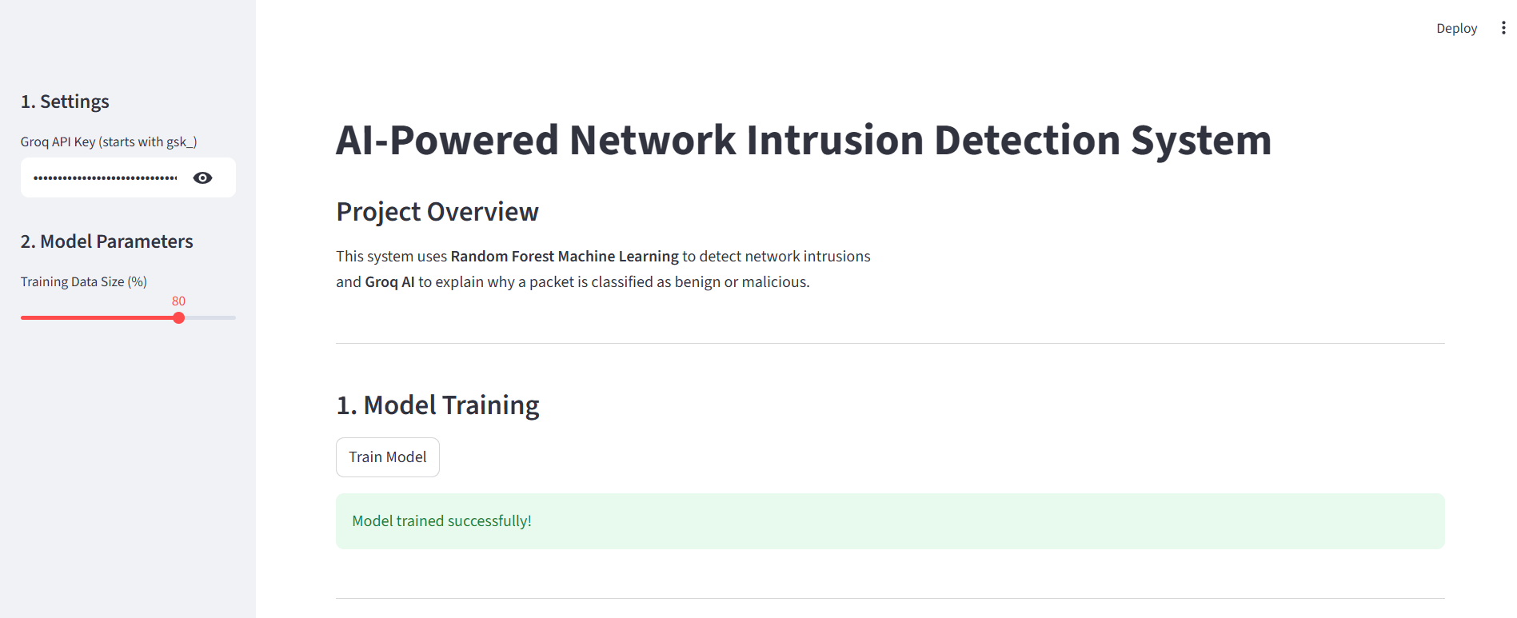
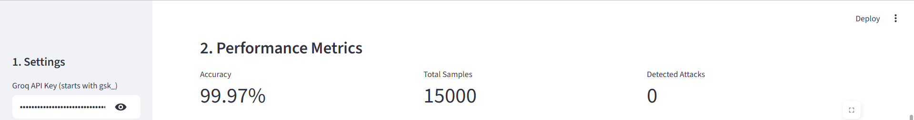
RESULTS
[Add screen shots of your code ]
Demo Link

Slide 7
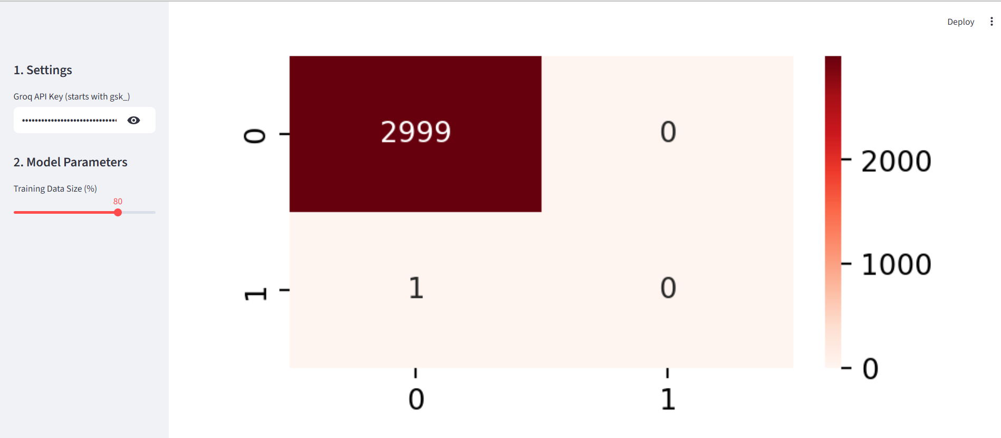
RESULTS
[Add screen shots of your code ]
Demo Link

Slide 8
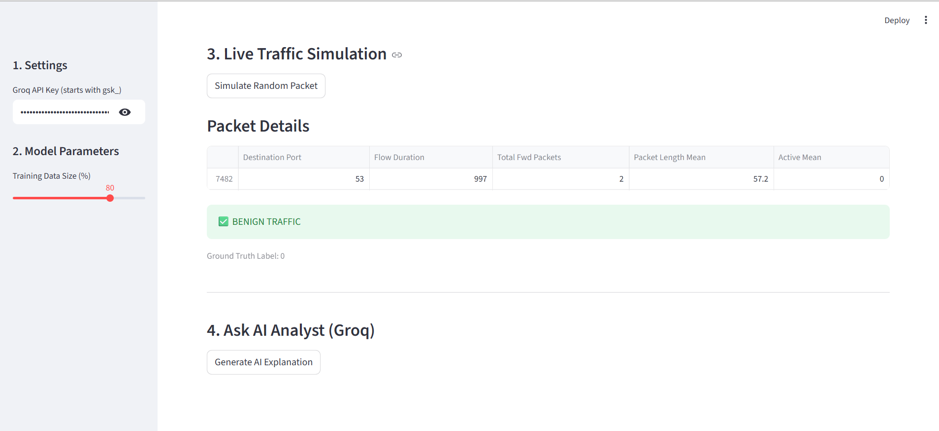
RESULTS
Demo Link

Slide 9
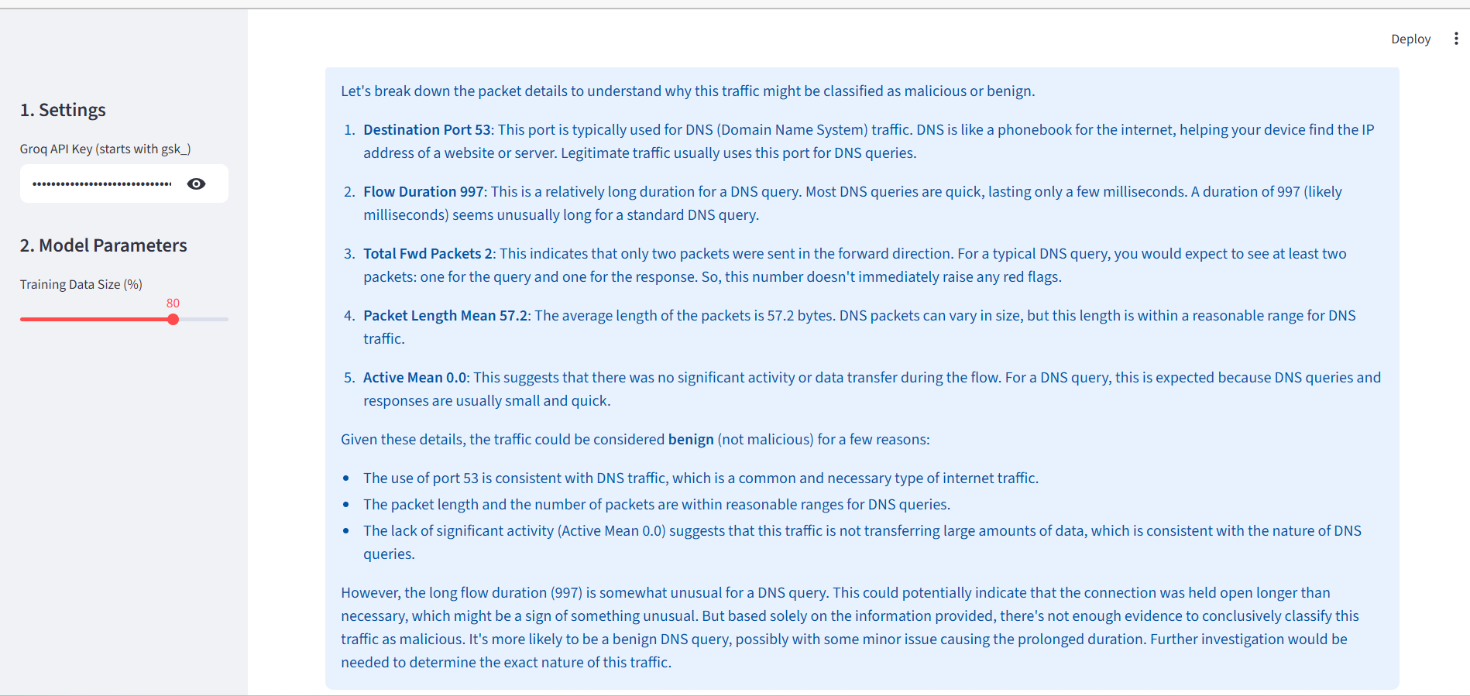
RESULTS
Demo Link

Slide 10
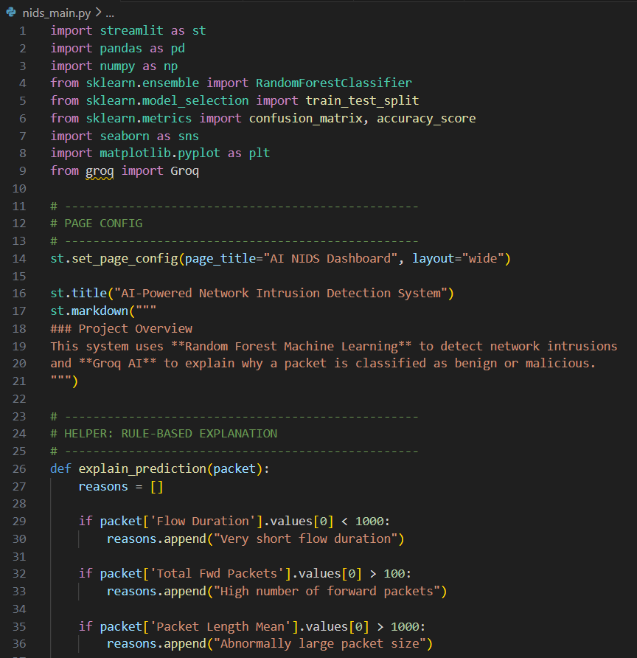
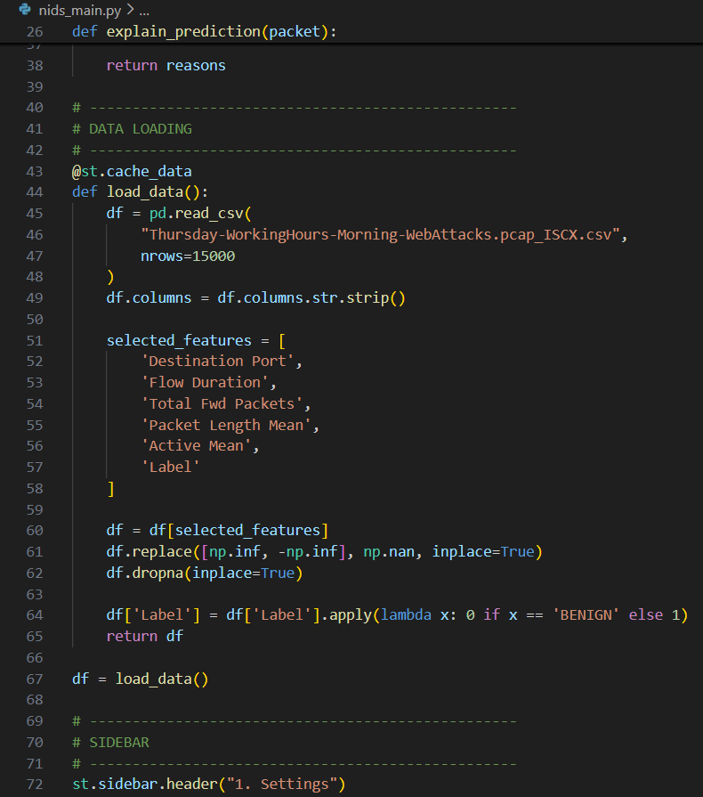
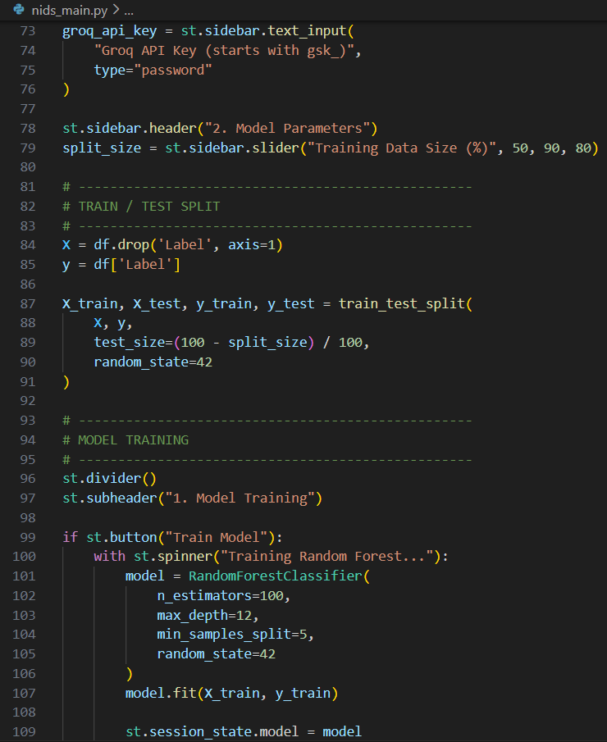
RESULTS
Demo Link

Slide 11
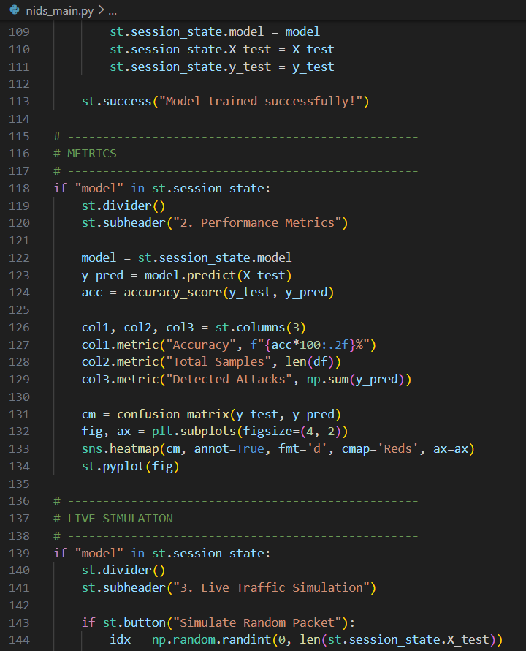
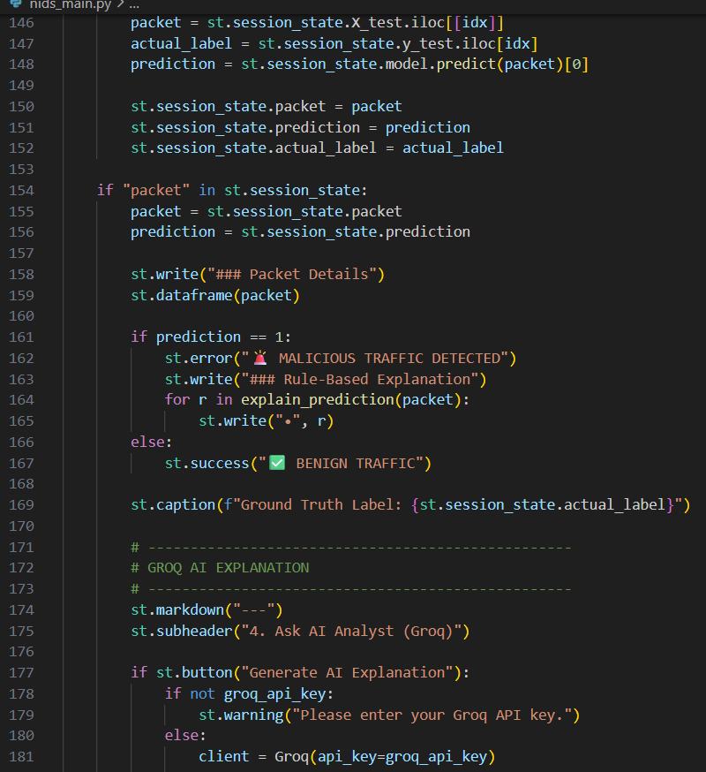
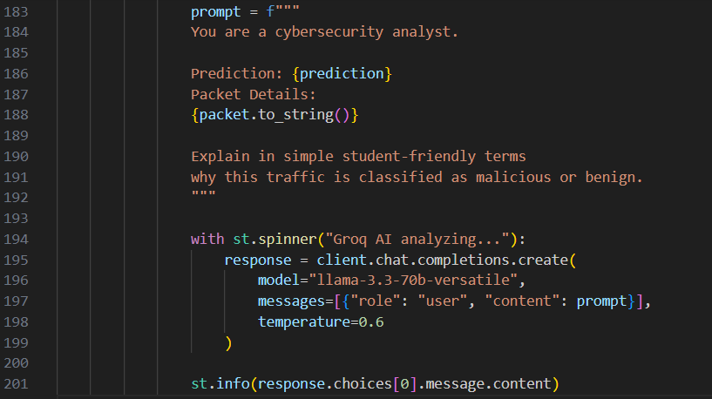
RESULTS
[Add screen shots of your code ]
Demo Link

Slide 12

Certificate - Protection from browser attacks

Slide 13
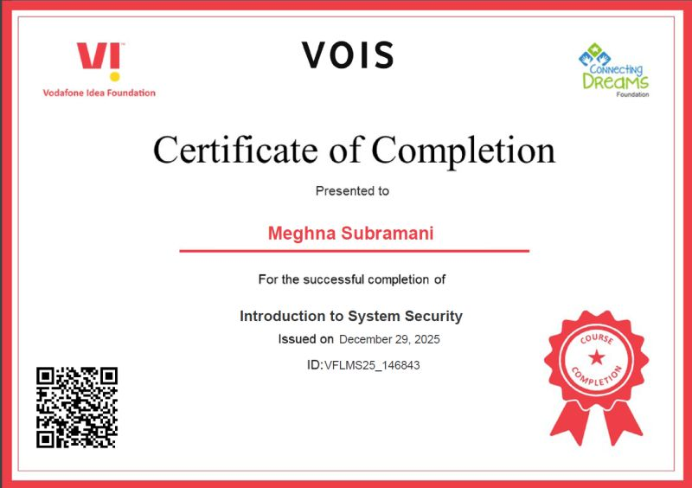
Certificate - Introduction to System Security

Slide 14
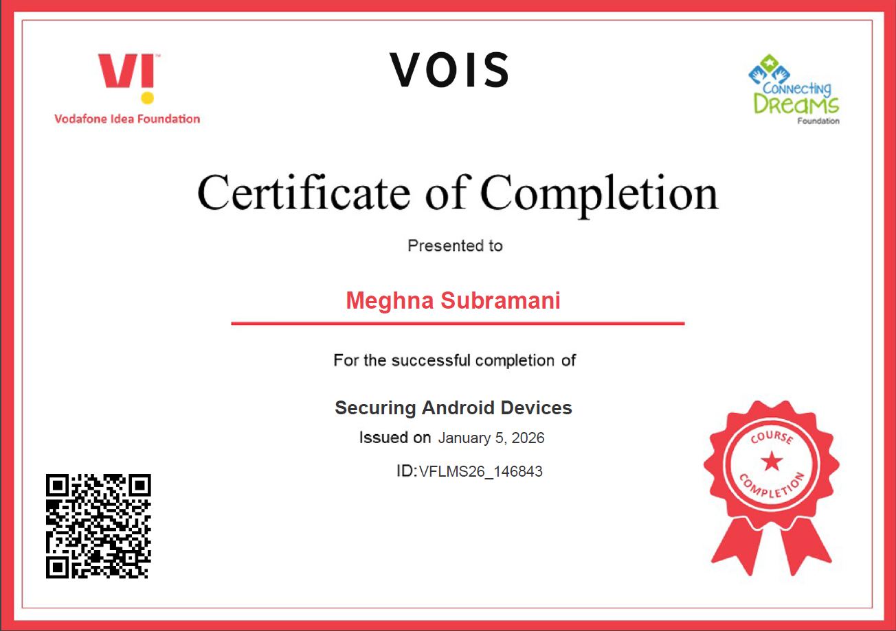
Certificate - Securing Android Devices

Slide 15
GitHub link
GitHub link: https://github.com/Meghna2706/VOIS
Hugging Face link: https://huggingface.co/spaces/me-27/AI_NIDS_PROJECT/tree/main
Demo: https://drive.google.com/file/d/1DaocVuO_f5CncCalJPNEzdyq3KTrwSnY/view?usp=drive_link

Slide 16
Thank you
.
.

